Slide 1


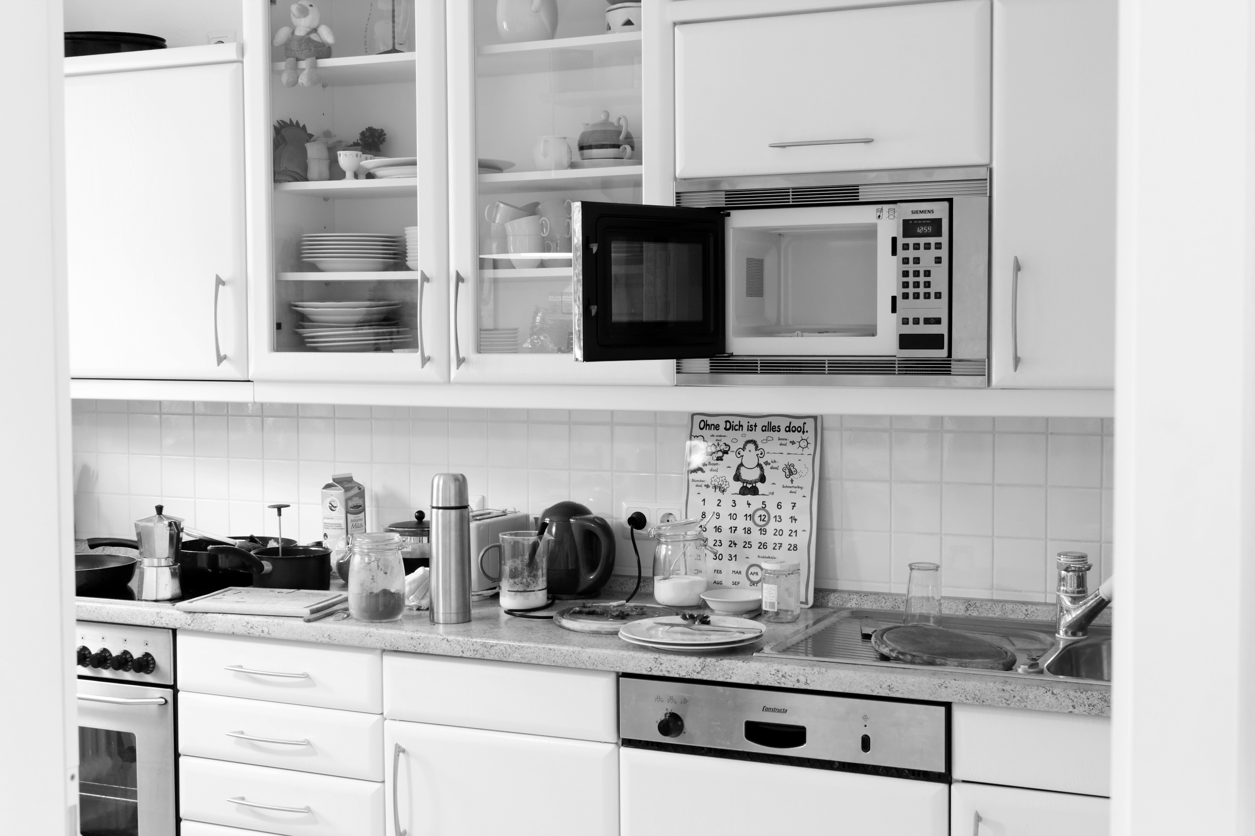
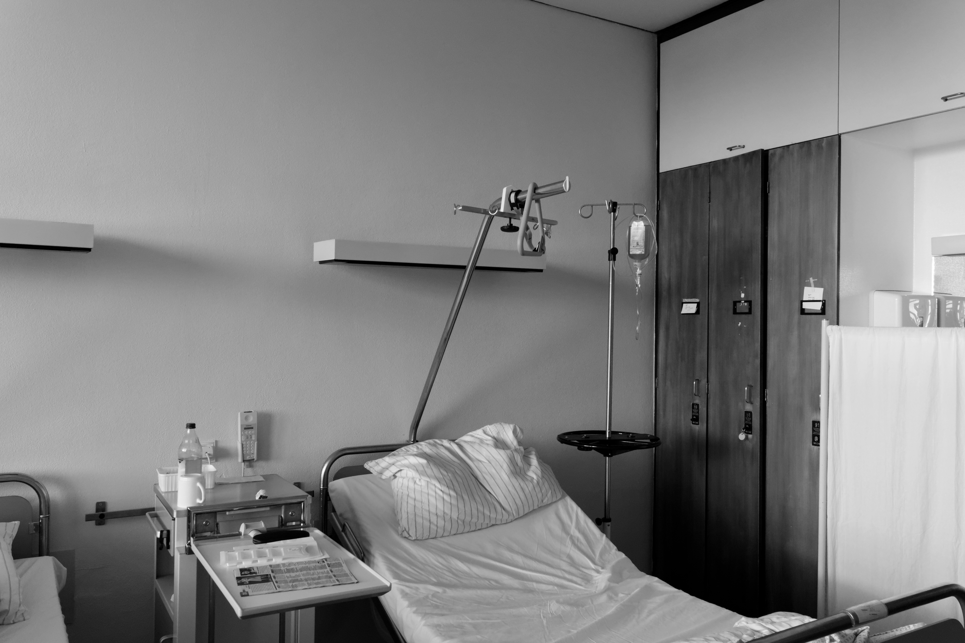
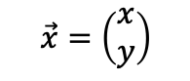

A
40 Scenes
scene and target stimulus projected:
$$\left(\begin{matrix}−1 & 0 \\ 0 & 1\end{matrix}\right) \vec{x}=\left(\begin{aligned}−x \\ y\end{aligned}\right)$$
$$\vec{x}=\left(\begin{aligned}x \\ y\end{aligned}\right)$$
T
T
B
Target stimulus
: Random sample draws
Initial scene pool N = 40
n = 10 new
Block 1
Block 2
n = 30 training scenes
n = 10 original
n = 10 mirrored
n = 10 dropped
C
+
+
Block 1
+
Block 2
⎪
⎪
original
mirrored
new

